Slide 1
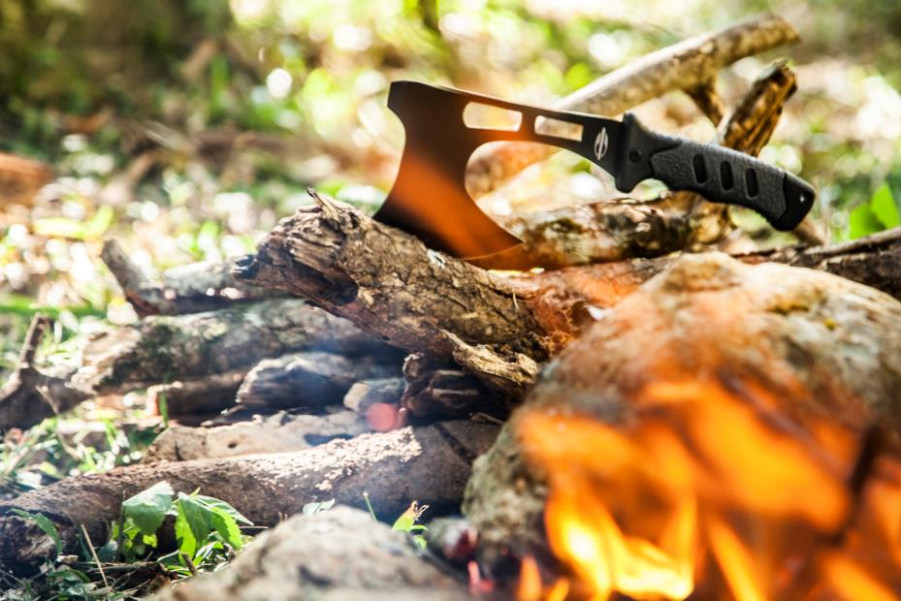
MORMAII
CAMPING 2014/2015

Slide 2
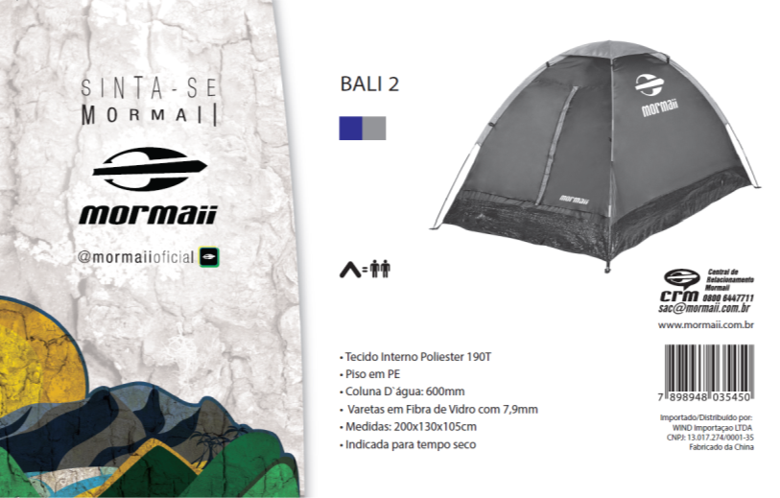
BALI 2 – BLUE – USD 8,10

Slide 3
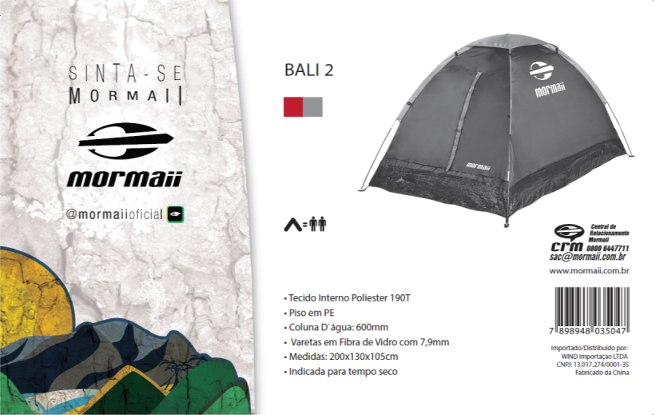
BALI 2 – RED – USD 8,10

Slide 4
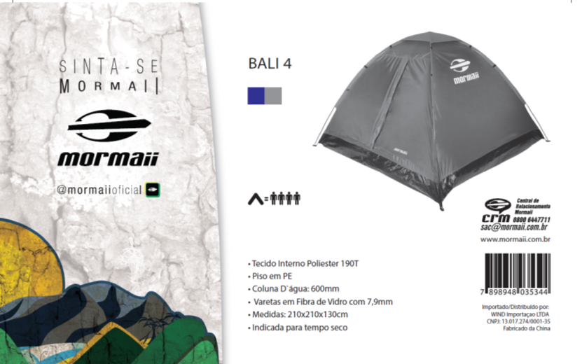
BALI 4 – BLUE – USD 10,94

Slide 5
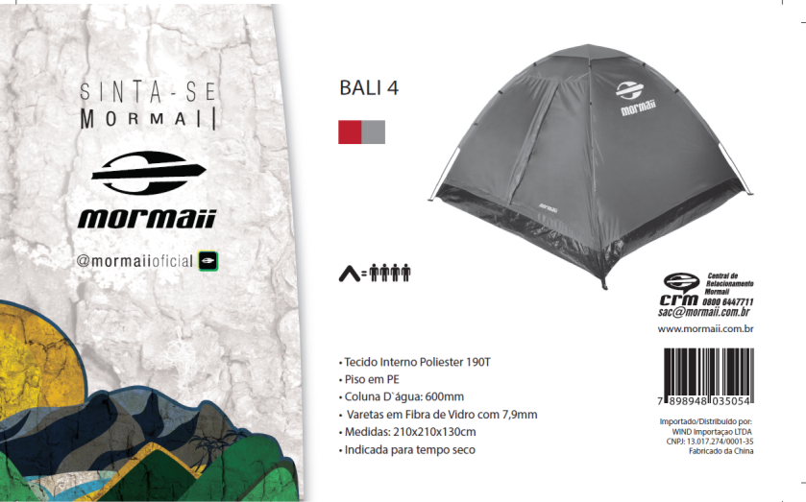
BALI 4 – RED – USD 10,94

Slide 6
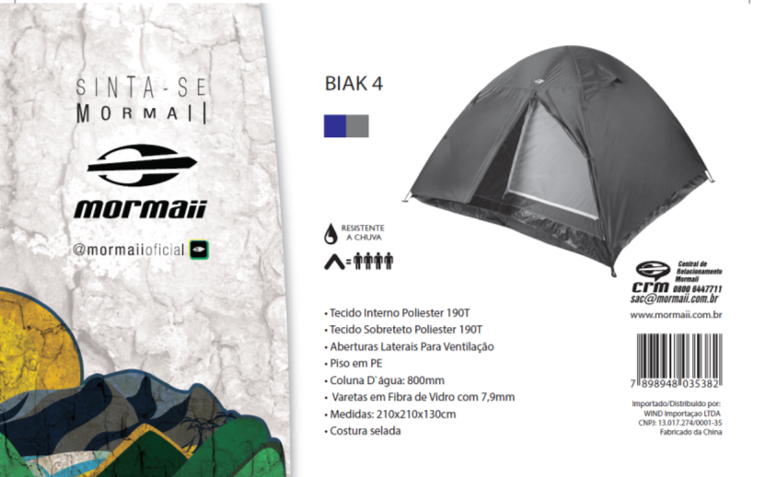
BIAK 4 – BLUE – USD 19,40

Slide 7
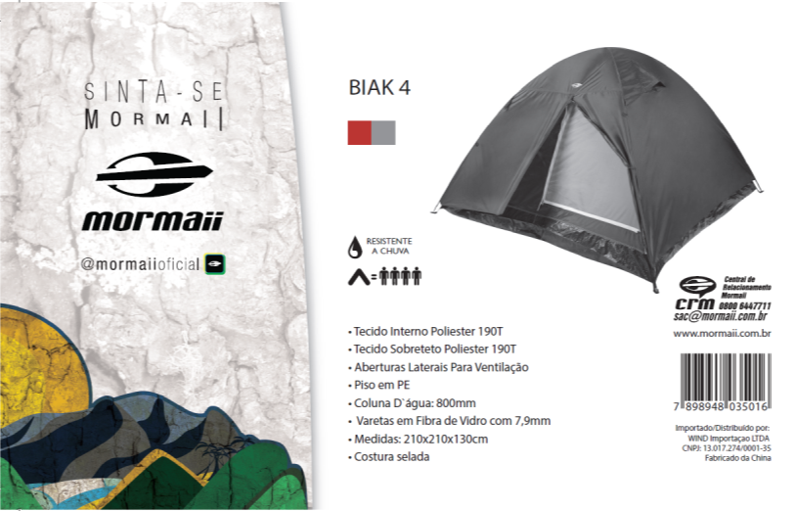
BIAK 4 – RED – USD 19,40

Slide 8
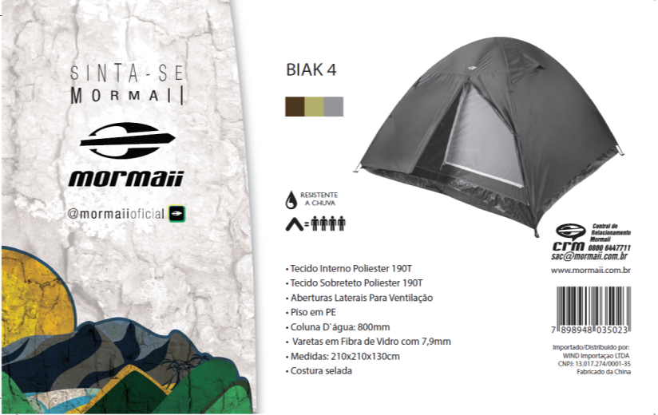
BIAK 4 – GREEN – USD 19,40

Slide 9
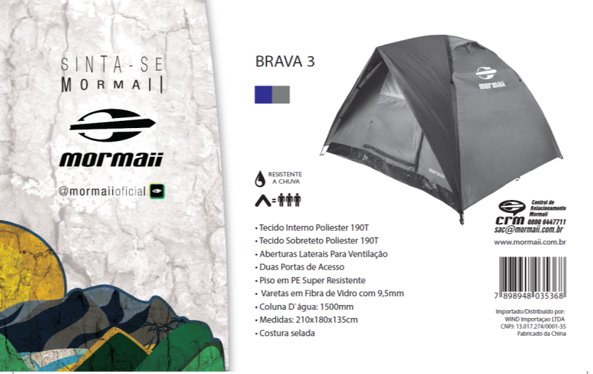
BRAVA 3 – BLUE – USD 19,50

Slide 10
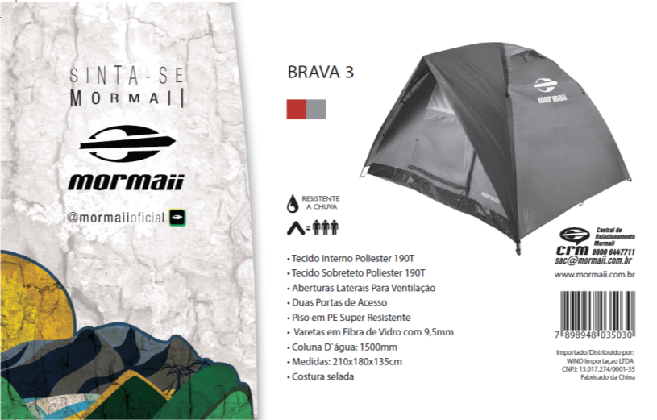
BRAVA 3 – RED – USD 19,50

Slide 11
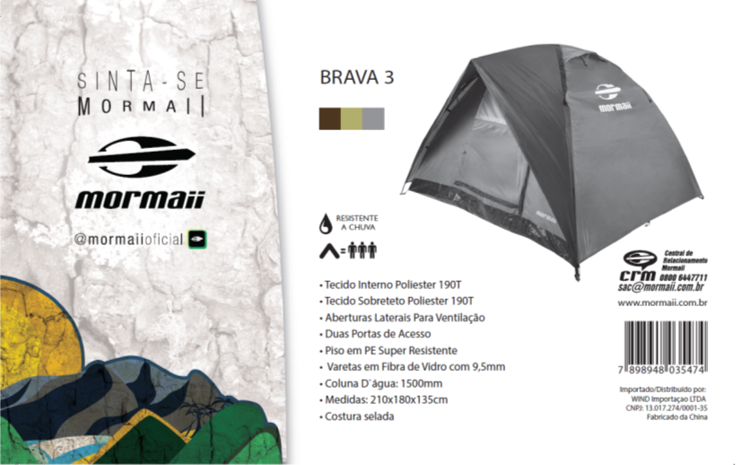
BRAVA 3 – GREEN – USD 19,50

Slide 12
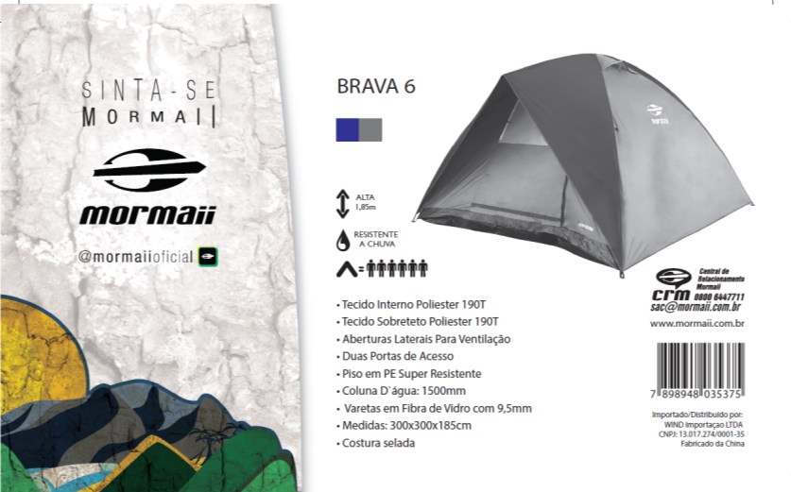
BRAVA 6 – BLUE – USD 38,80

Slide 13
BRAVA 6 – RED – USD 38,80

Slide 14
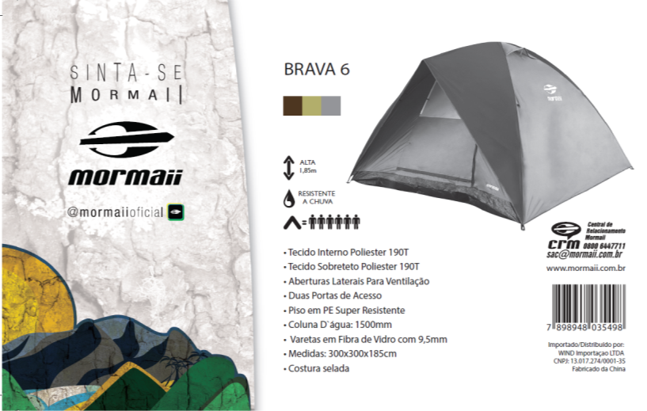
BRAVA 6 – GREEN – USD 38,80

Slide 15
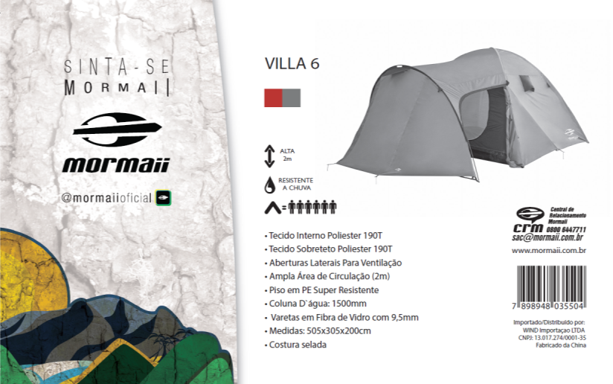
VILLA 6 – RED – USD 51,00

Slide 16
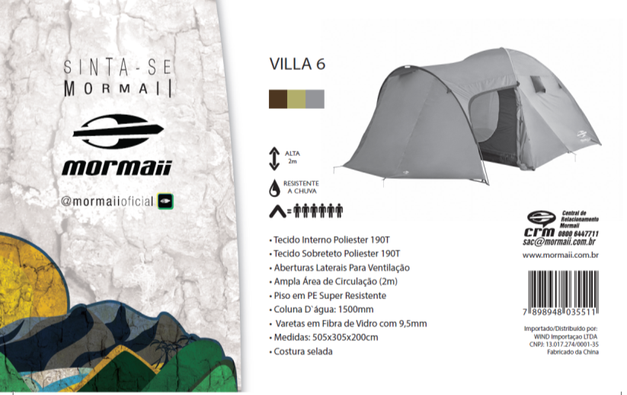
VILLA 6 – GREEN – USD 51,00

Slide 17
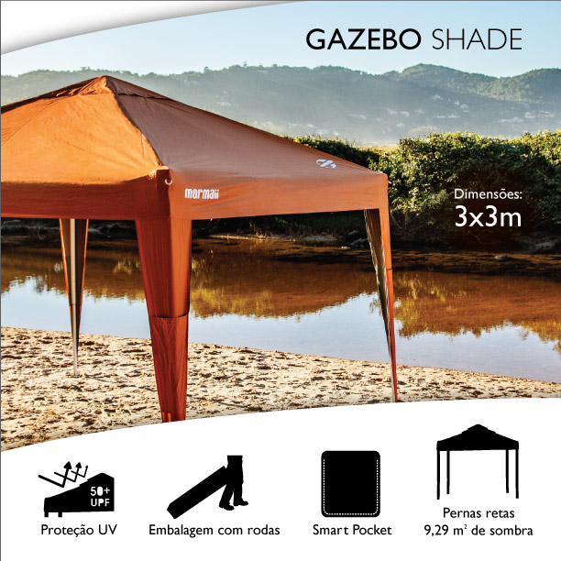
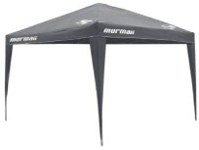
FOLDABLE GAZEBO SHADE
ORANGE OR GREY
USD 49,95

Slide 18
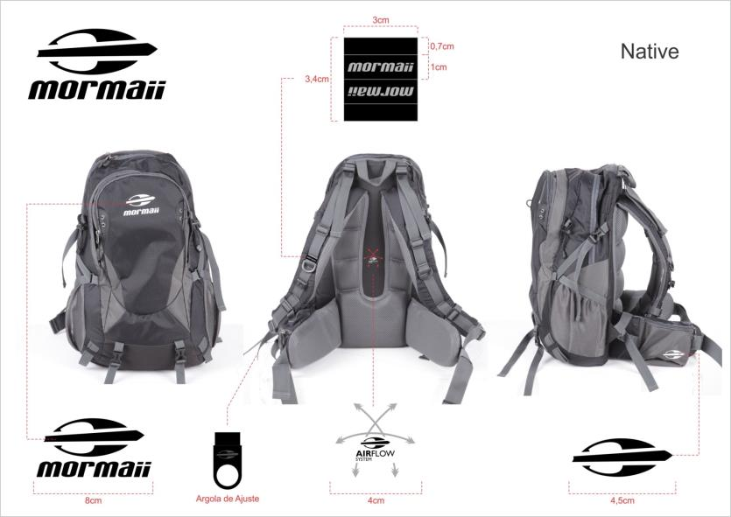
NATIVE BLACK – 30 LITERS - USD 19,70

Slide 19
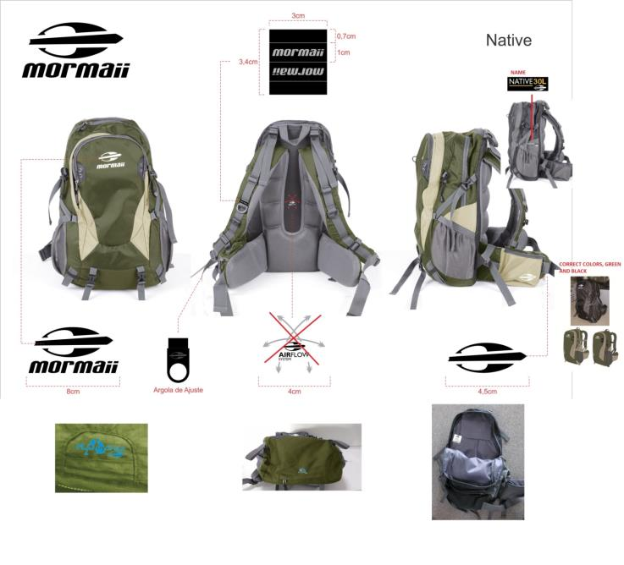
NATIVE GREEN – 30 LITERS - USD 19,70

Slide 20
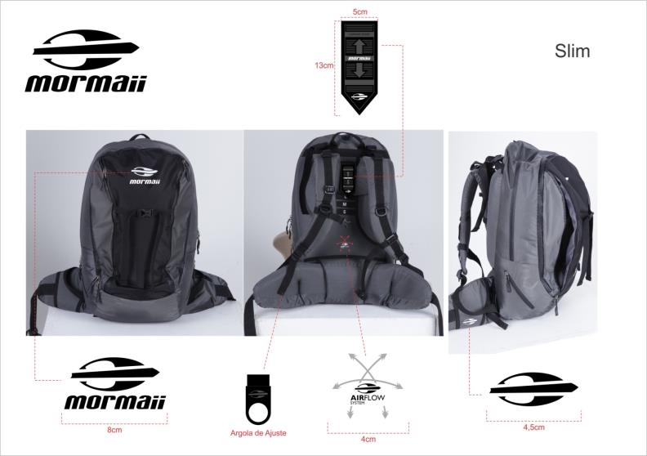
SLIM – 35 LITERS – USD 16,93

Slide 21
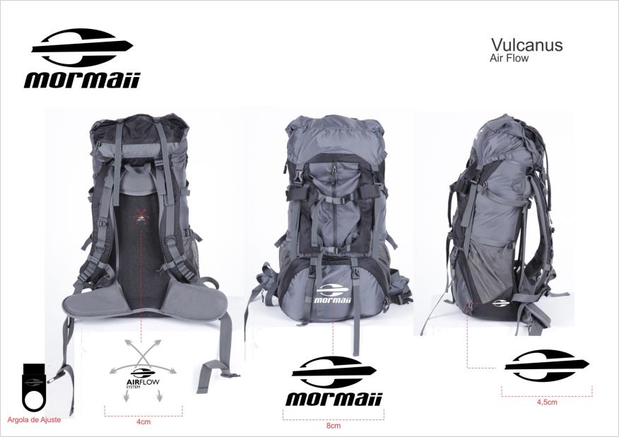
VULCANUS – 45 LITERS – USD 28,95

Slide 22
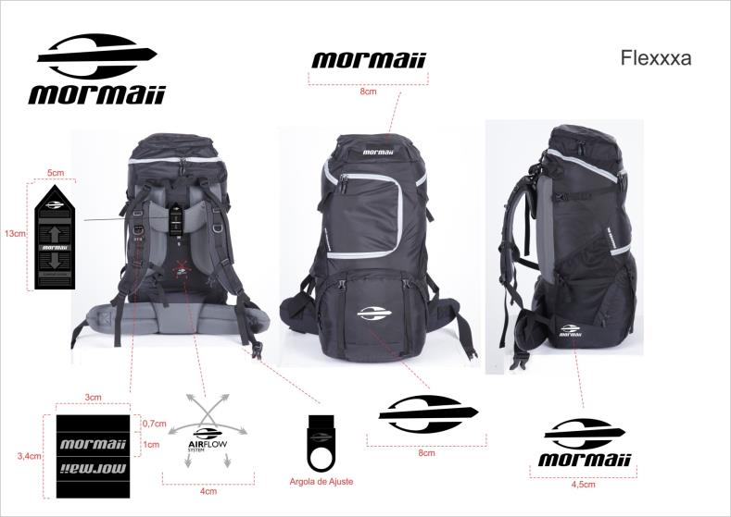
FLEXXXA – 60 LITERS - USD 35,22

Slide 23
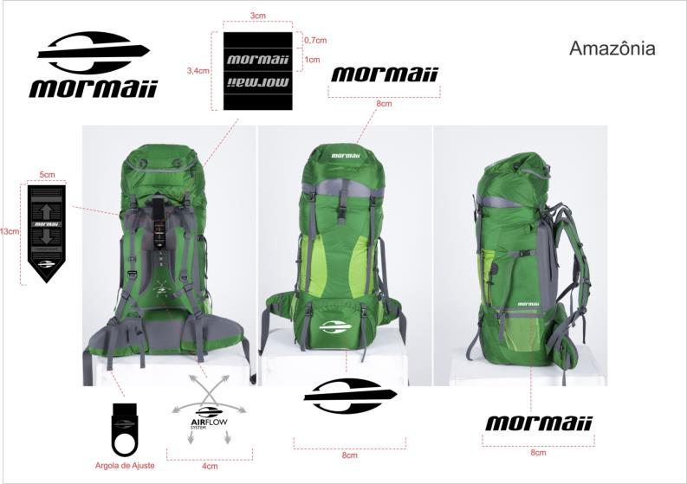
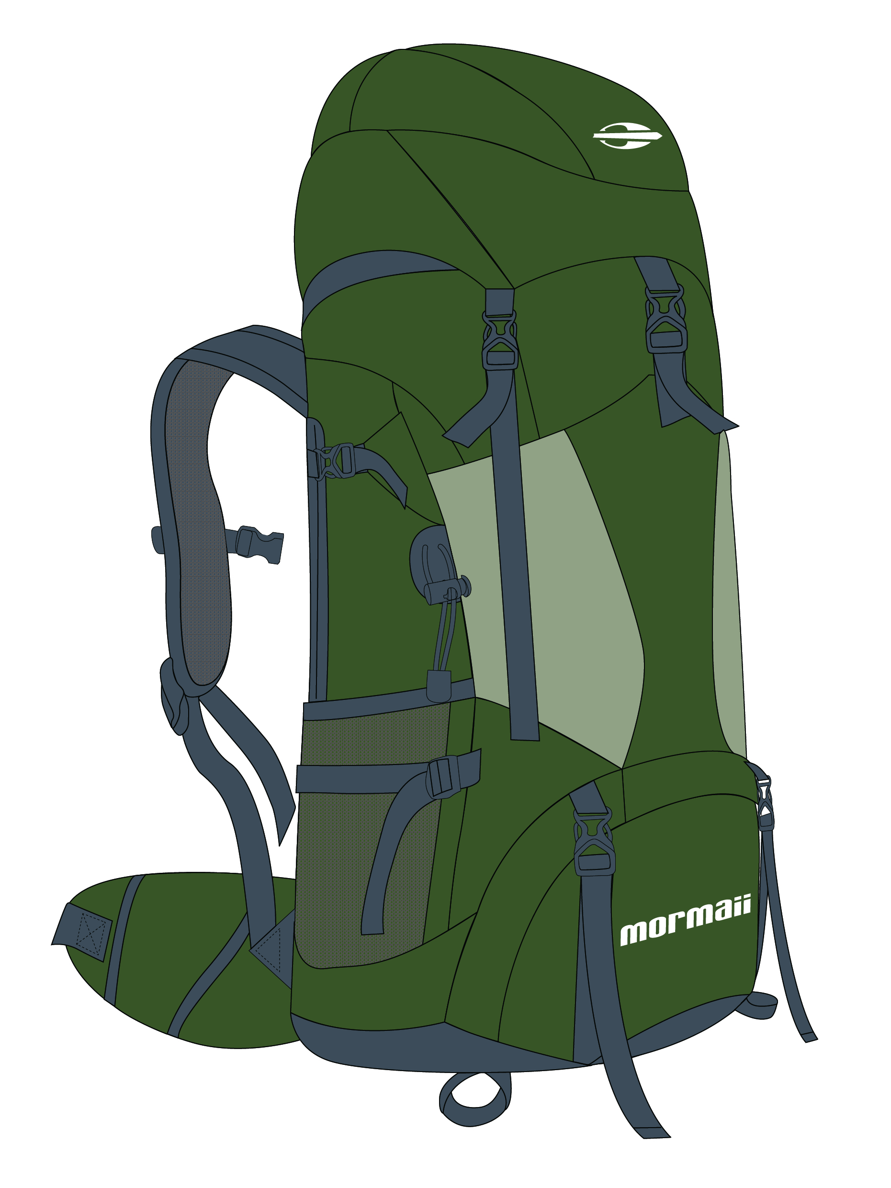
CORRECT COLOR
AMAZONIA – 80 LITERS – USD 37,70

Slide 24
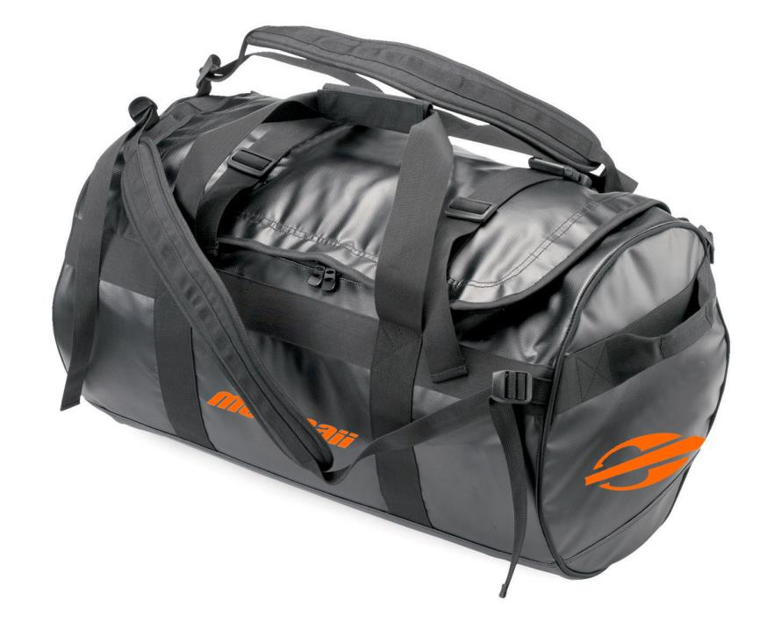
STORM – 90 LITERS - USD 18,28

Slide 25
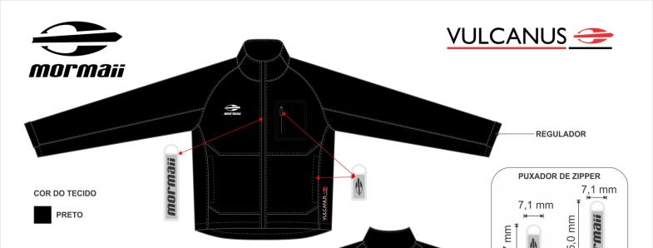
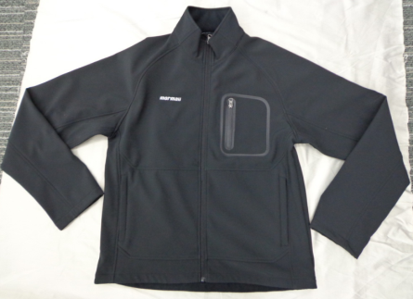
VULCANUS BLACK– USD 17,14

Slide 26
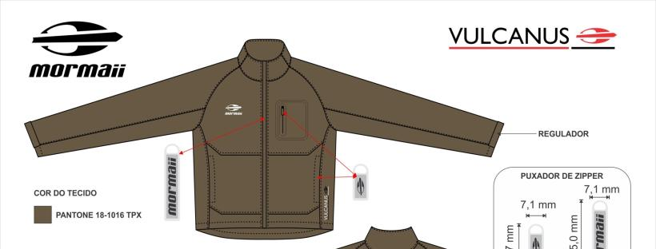
VULCANUS BROWN– USD 17,14

Slide 27
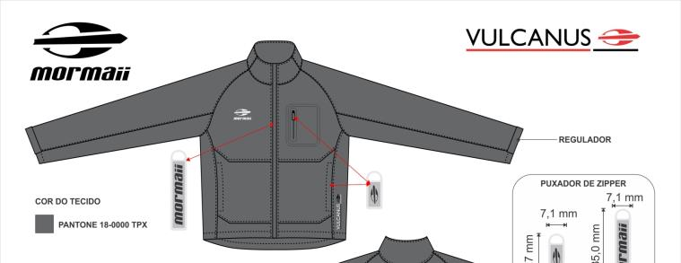
VULCANUS GREY– USD 17,14

Slide 28
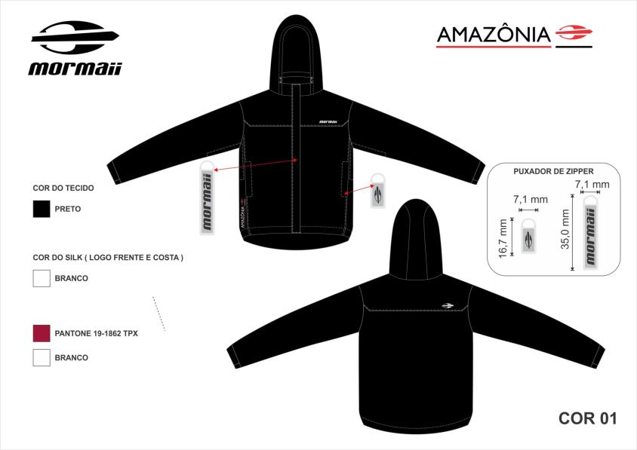
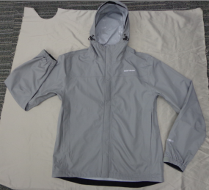
AMAZONIA BLACK – USD 17,55

Slide 29
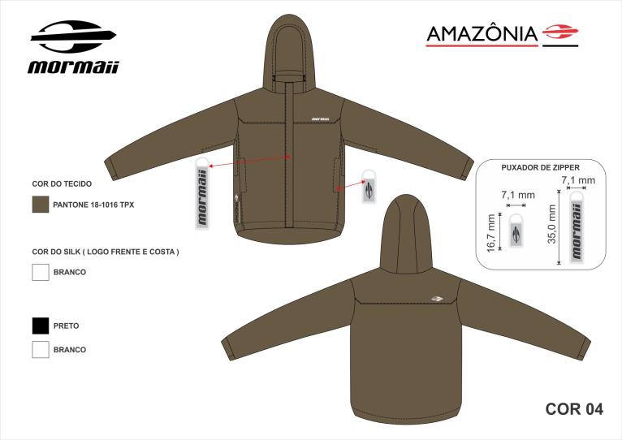
AMAZONIA BROWN – USD 17,55

Slide 30
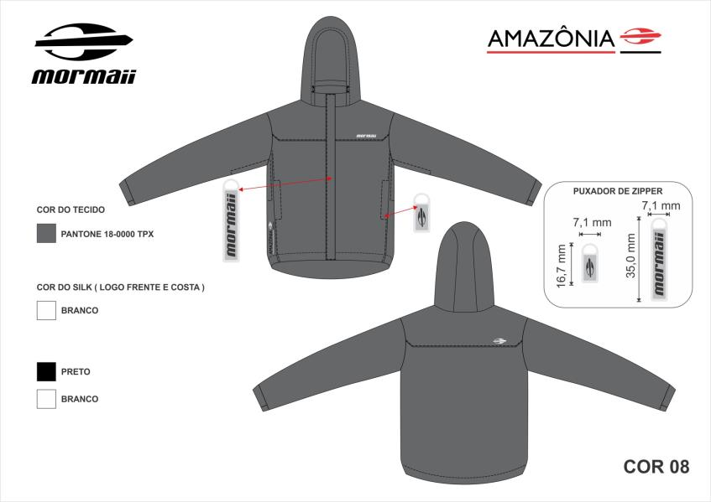
AMAZONIA GREY – USD 17,55

Slide 31
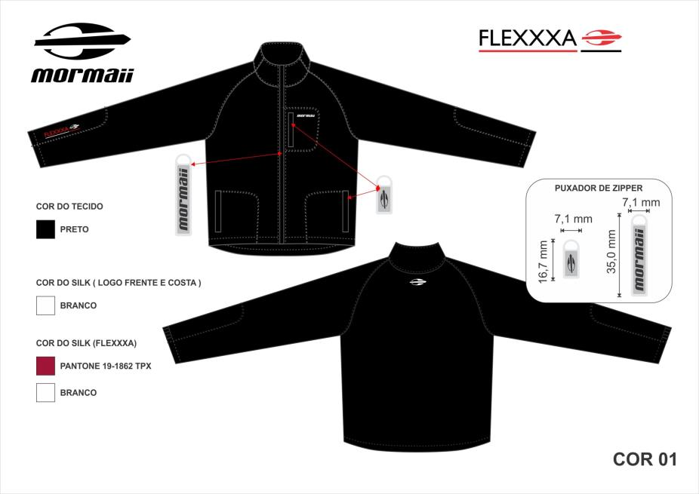
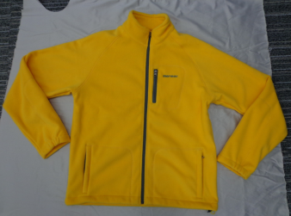
FLEXXXA BLACK – USD 9,45

Slide 32
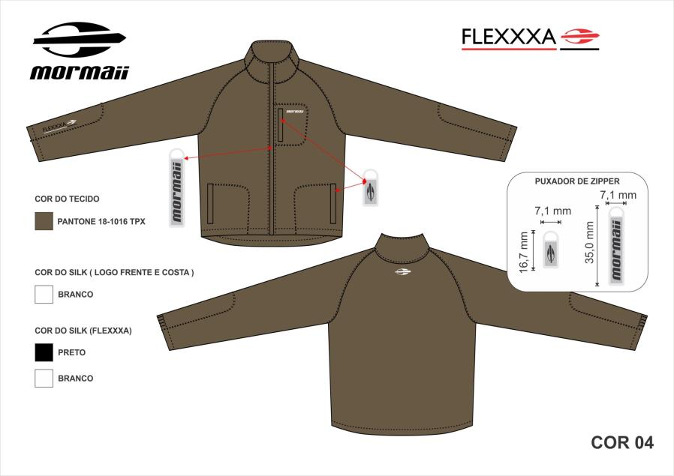
FLEXXXA BROWN – USD 9,45

Slide 33
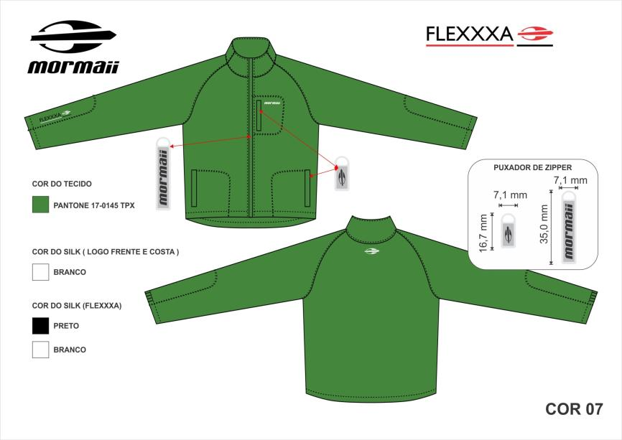
FLEXXXA GREEN– USD 9,45

Slide 34
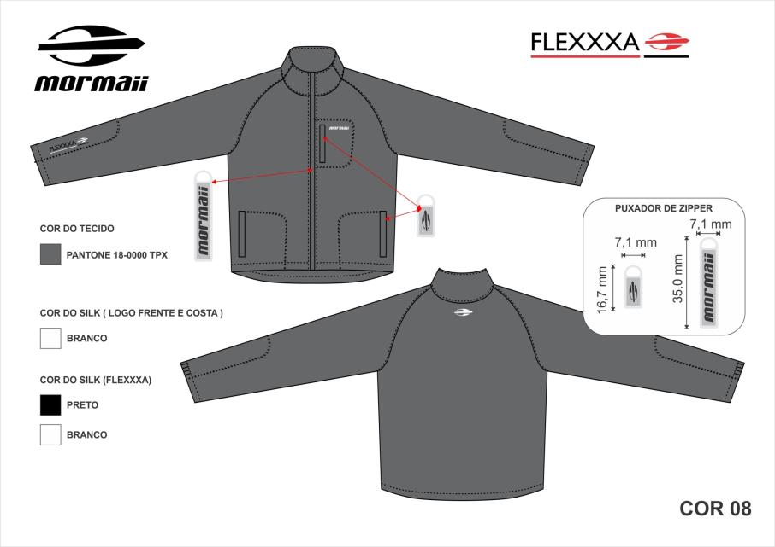
FLEXXXA GREY – USD 9,45

Slide 35
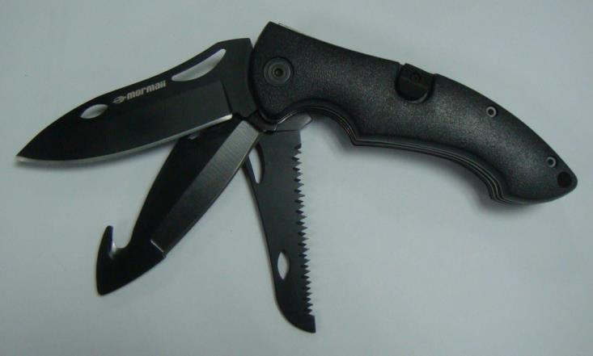
TRIPLE– USD 7,98

Slide 36
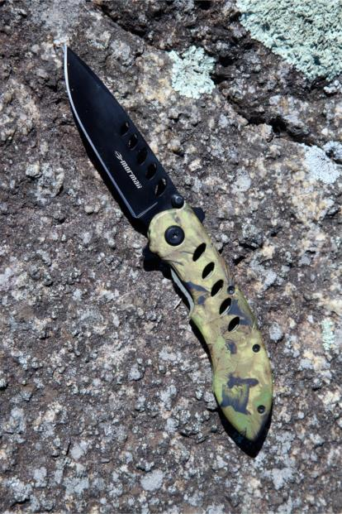
SAHARA – USD 3,77

Slide 37
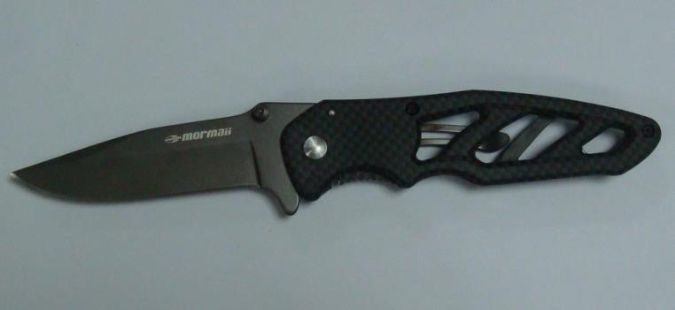
CARBON I – USD 4,5

Slide 38
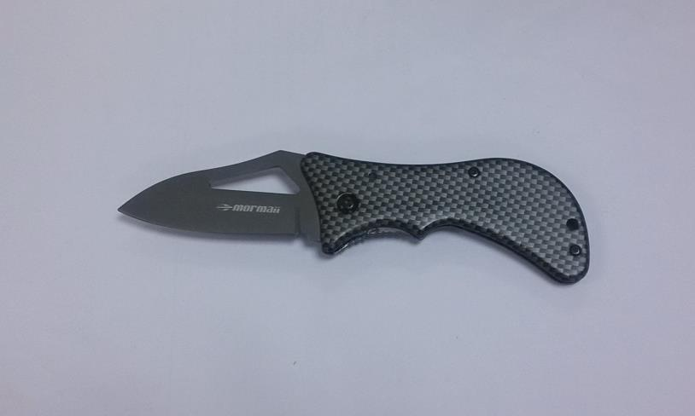
CARBON II – USD 3,5

Slide 39
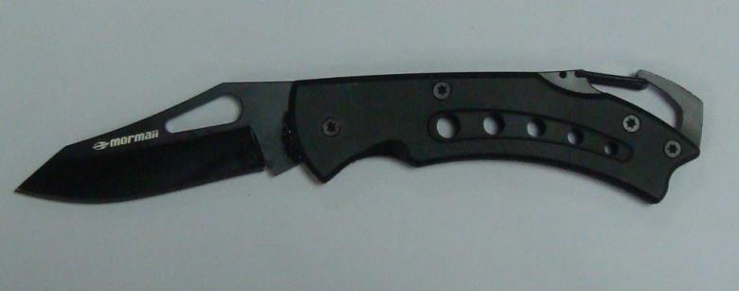
NANO BLACK – USD 1,90

Slide 40
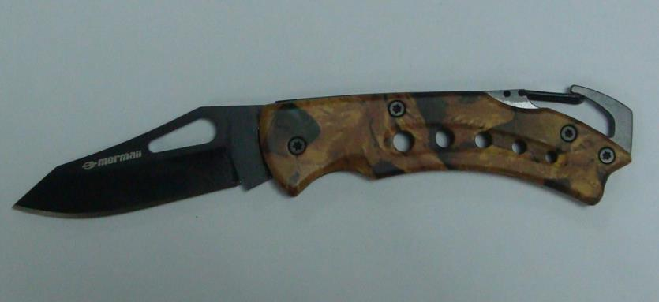
NANO SAVAGE – USD 2,05

Slide 41
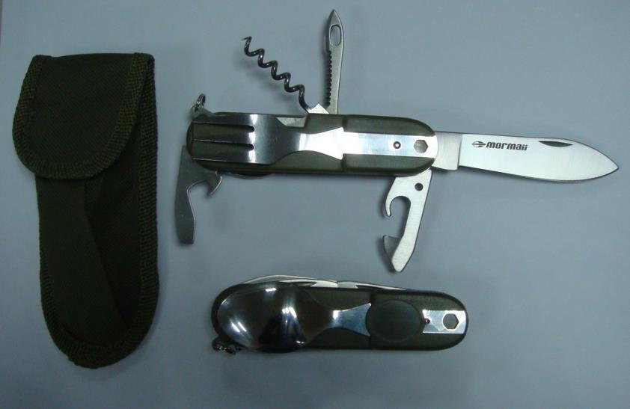
MINI VALAIS – USD 2,5

Slide 42
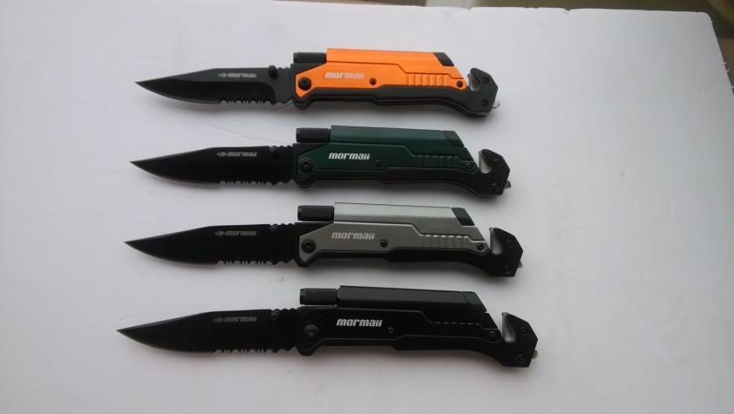
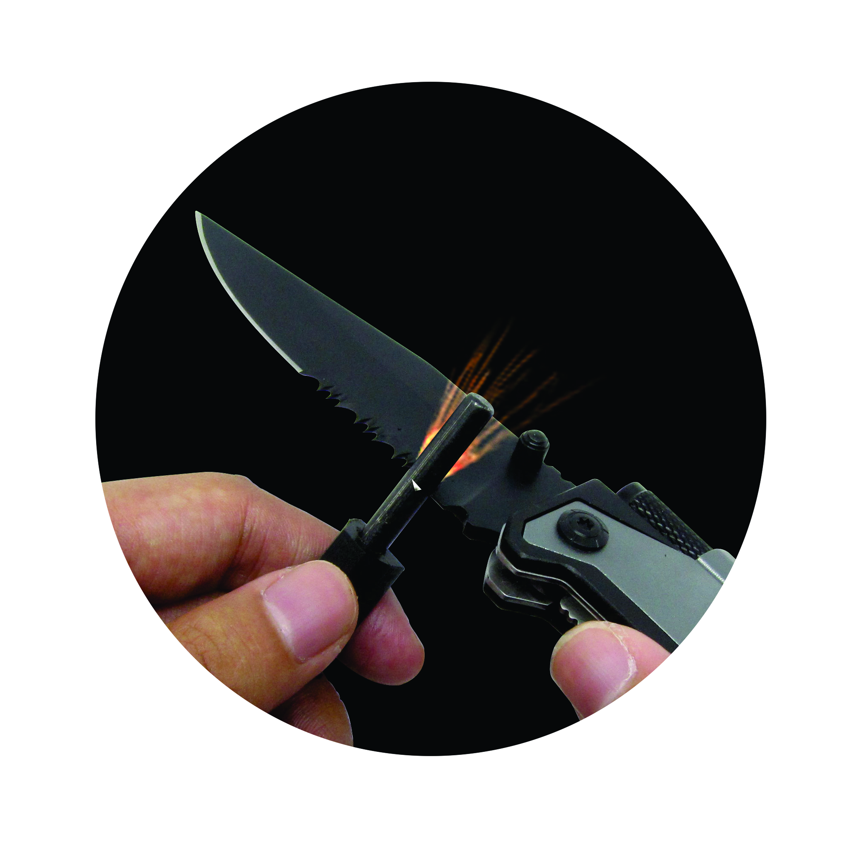
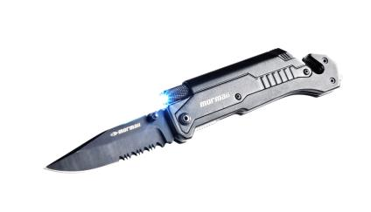
BRIGADE ORANGE – USD 4,98
BRIGADE GREEN – USD 4,98
BRIGADE SILVER – USD 4,98
BRIGADE BLACK – USD 4,98

Slide 43
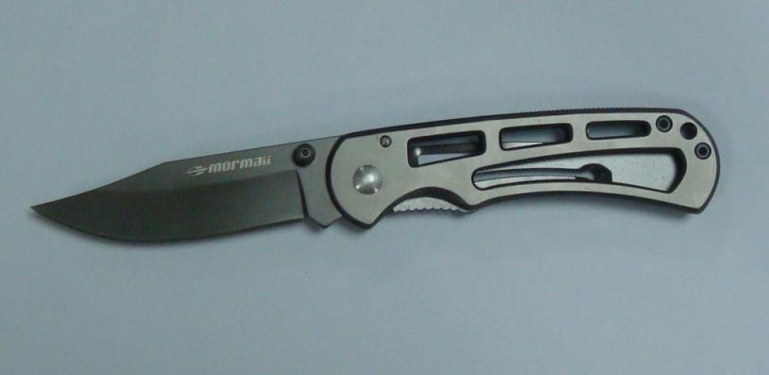
TITAX – USD 4,05 – TITANIUM BLADE

Slide 44
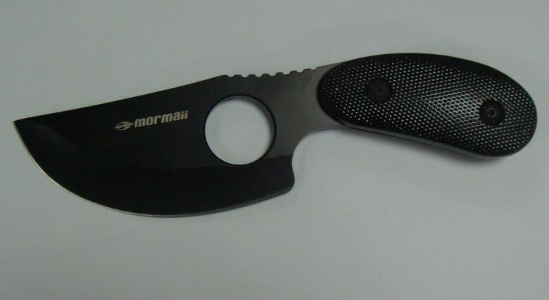
GRIP – USD 3,5

Slide 45
RUBBER KUKRI – USD 7,65

Slide 46
RUBBER MACHETE – USD 7,20

Slide 47
EDGE BLACK – USD 4,71

